Slide 1

IOT BASED AIR MONITERING SYSTEM
Presented By:-
Sayani Paul 24400317018
Sarbodarshi Mitra 24400317019
Ankita Kundu 24400317049
Ankita Ghosh 24400317050
Under The Guidance of
Prof. Tanushree Saha
Assistant Professor
Dept. of ECE

Slide 2

POINTS TO BE COVERED
Introduction
Aim and Objectives
Required Components
Components Explanation
Block Diagram and Working Principal
Circuit Diagram and Explanation
Advantages
Applications
Future Scope

Slide 3
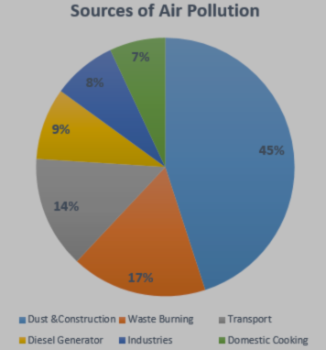
INTRODUCTION
When air get mixed with harmful gases and substances then it is called air pollution.
The major pollutants such as NH3,CO,CO2,SO2 etc.
Sources of air pollutants.
Effects of air pollution.
What is IOT?

Slide 4
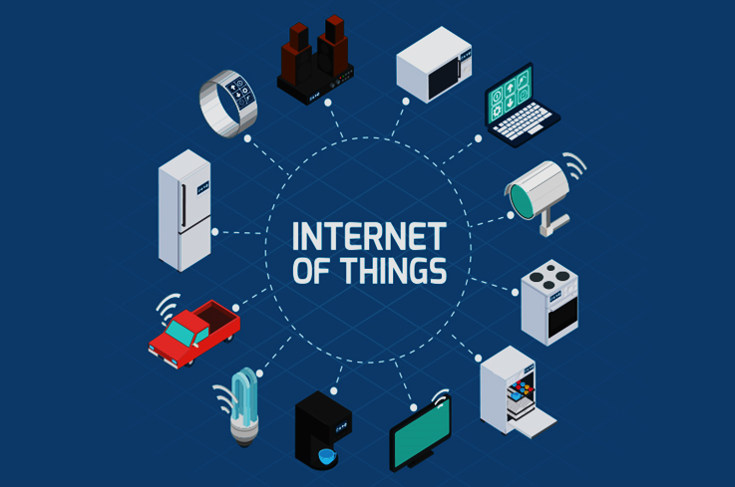
AIM and OBJECTIVES
To create an application which will monitor the quality of air in our environment.
By the sensors get the real time parameter of gases present in our surrounding air.
Display the data on LCD and also upload into server.

Slide 5

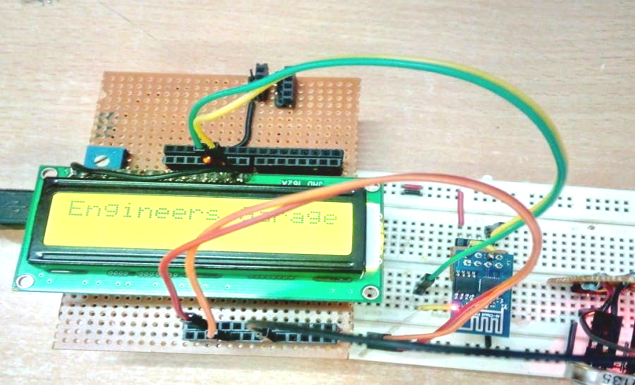
REQUIRED COMPONENTS
Arduino Uno
Wi-Fi module ESP8266
MQ135
Buzzer
16X2 LCD Display
Breadboard
10K potentiometer
1K ohm resistors
220 ohm resistor

Slide 6
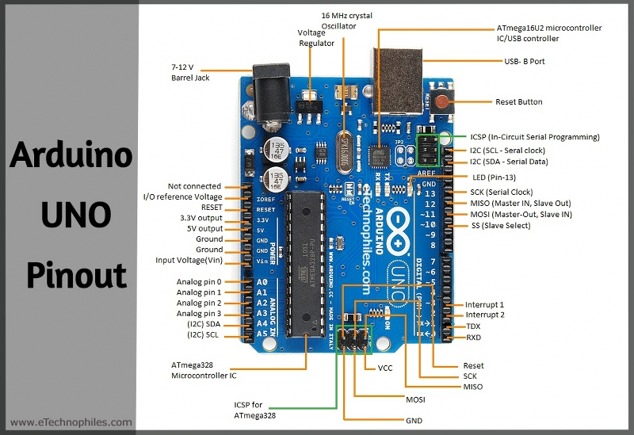
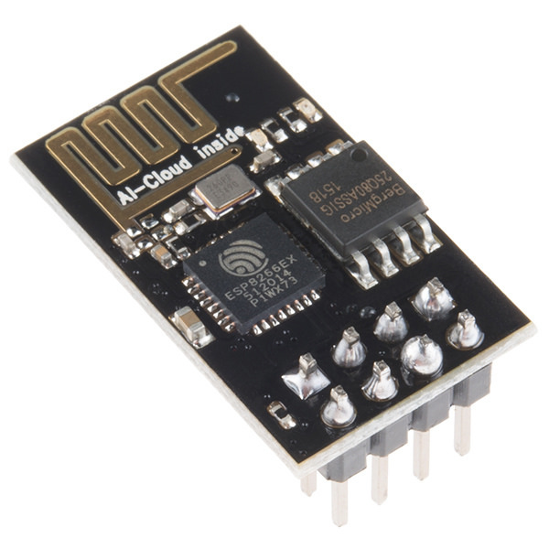
COMPONENTS EXPLANATION
Arduino Uno
Wi-Fi module ESP8266

Slide 7
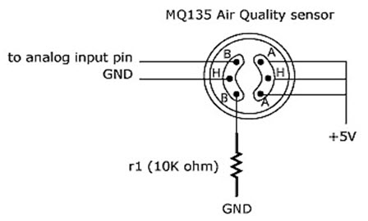
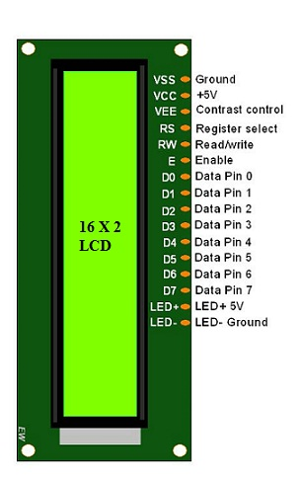
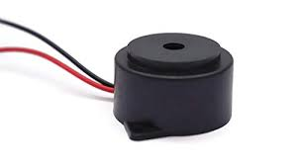
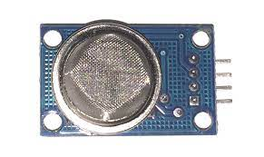
COMPONENTS EXPLANATION
MQ135
LCD Display
Buzzer

Slide 8
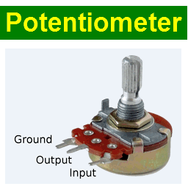
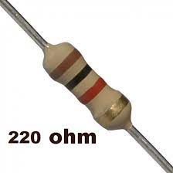
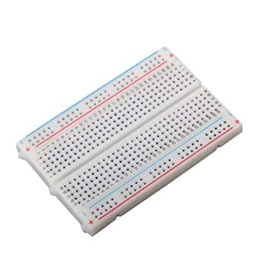
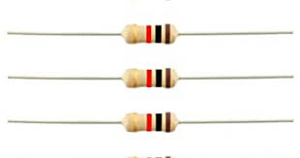
COMPONENTS EXPLANATION
1kohm resistors
220 ohm resistor
Breadboard
10K potentiometer
10K potentiometer
220 ohm resistor
Breadboard
1kohm resistors

Slide 9
BLOCK DIAGRAM

Slide 10
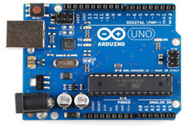
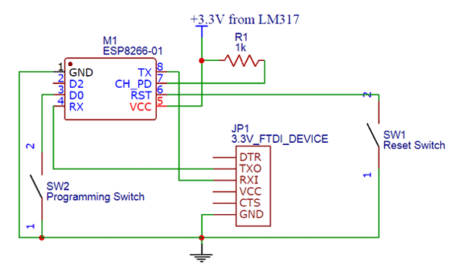

WORKING PRINCIPLE
The Arduino board has 10-bit ADC channels, so the digitized value ranges from 0 to 1023.
The device developed in this project can be installed near any Wi-Fi hotspot in a populated urban area.
The MQ135 sensor can sense NH3, NOx,alcohol, Benzene, smoke, CO2 and some other gases, so it is perfect gas sensor for our Air Quality Monitoring Project.

Slide 11
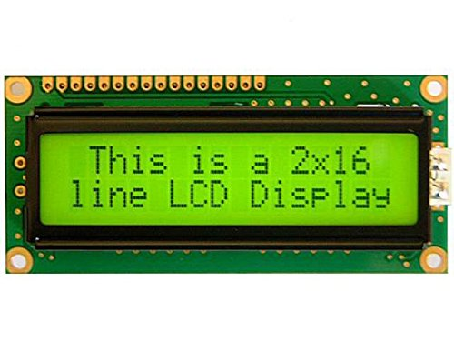
WORKING PRINCIPLE
Whenever the value will increase 1000 PPM, then the buzzer will start beeping
Air Quality <1000 PPM => “Fresh Air”.
Air Quality >1000 PPM => “Poor Air, Open Windows”.
Air Quality >2000 PPM => “Danger! Move to fresh Air”.

Slide 12
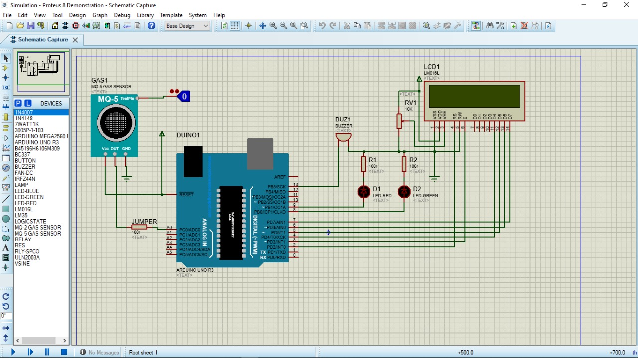
SIMULATION

Slide 13
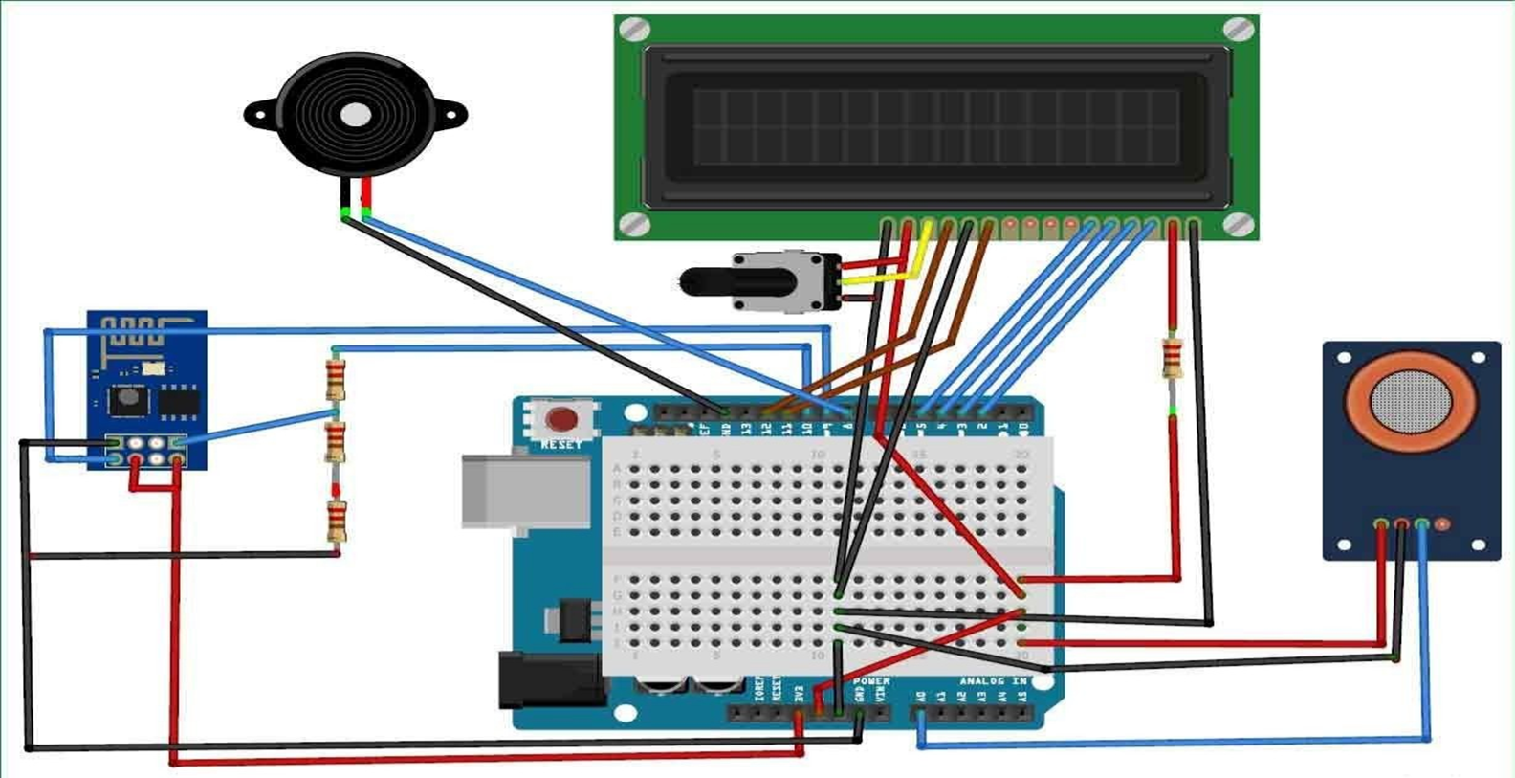
CIRCUIT DIAGRAM

Slide 14
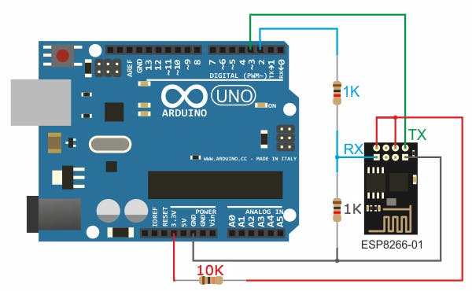
CIRCUIT DIAGRAM EXPLANATION
ESP8266 connection with Arduino UNO

Slide 15
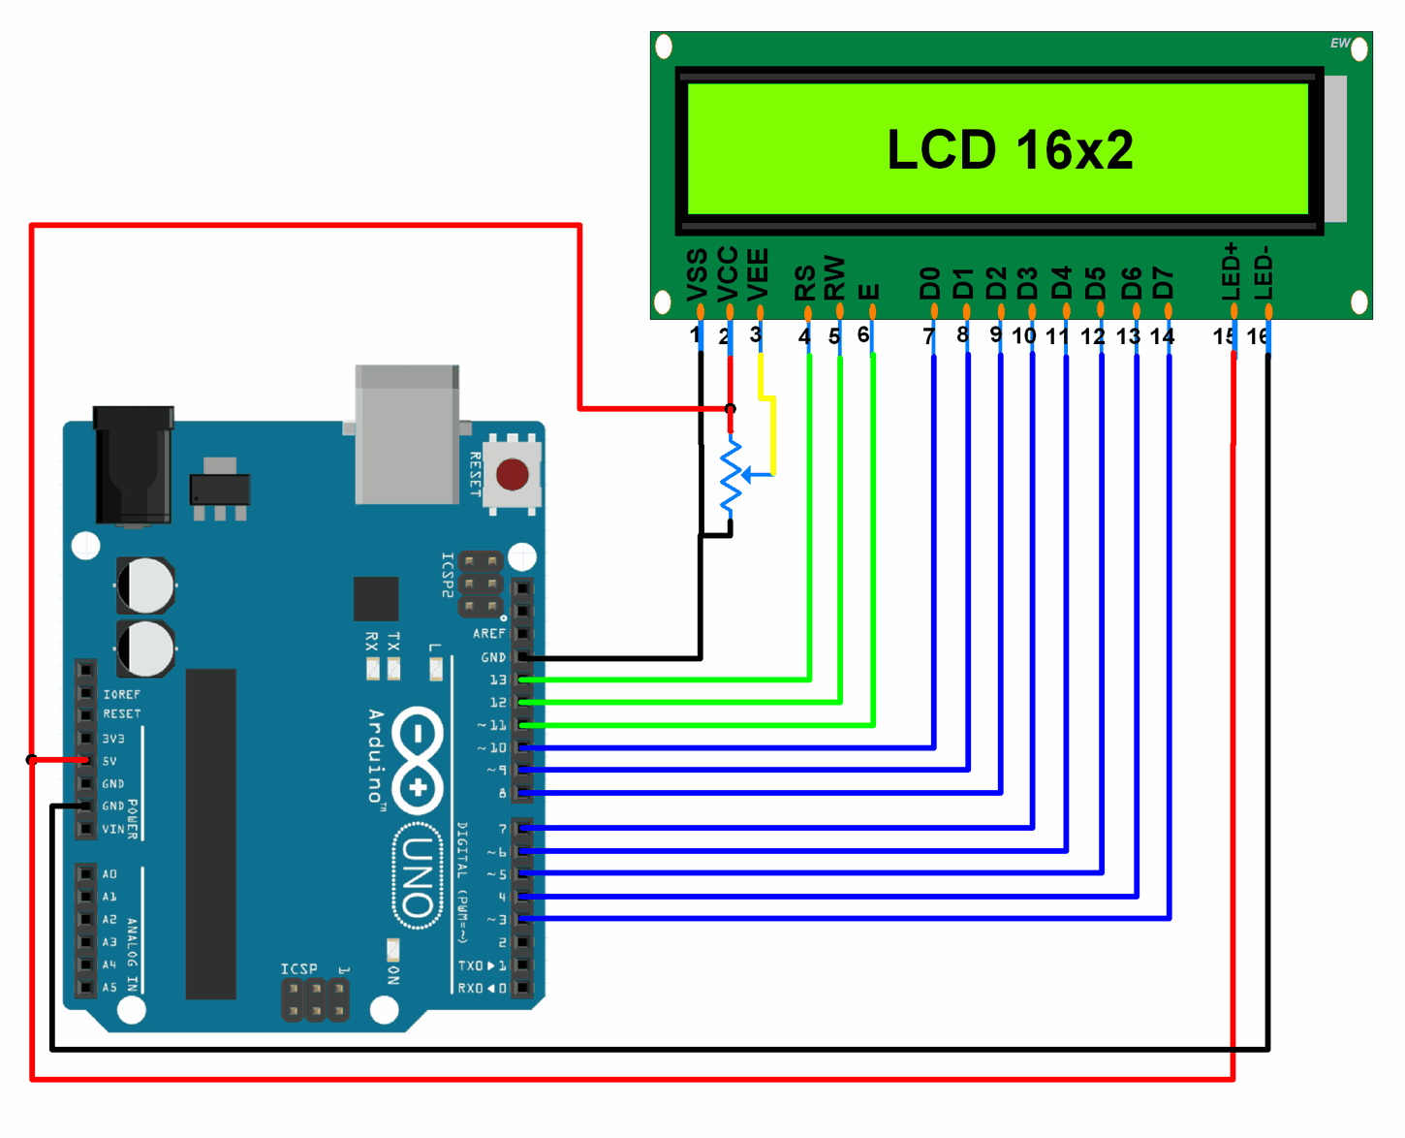
CIRCUIT DIAGRAM EXPLANATION
LCD connection with Arduino UNO

Slide 16
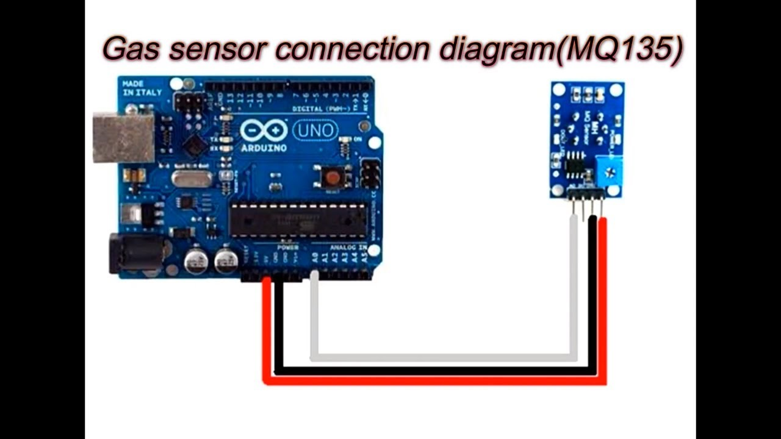
CIRCUIT DIAGRAM EXPLANATION
MQ135 sensor connection with Arduino UNO- Then we will connect the MQ135 with the Arduino. Connect the VCC and the ground pin of the sensor to the 5V and ground of the Arduino and the Analog pin of sensor to A0,A1,A2,A3 of the Arduino

Slide 17
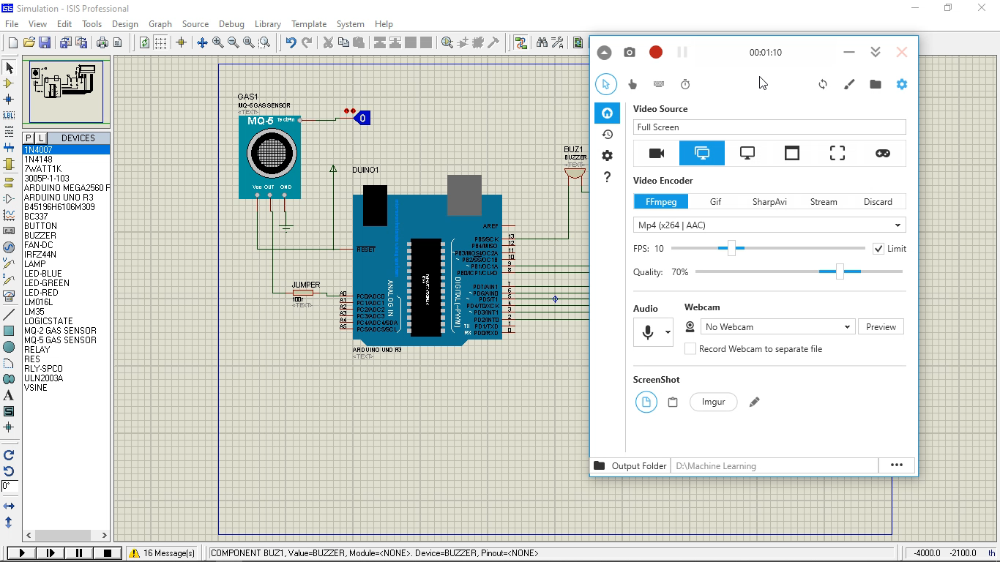

Slide 18
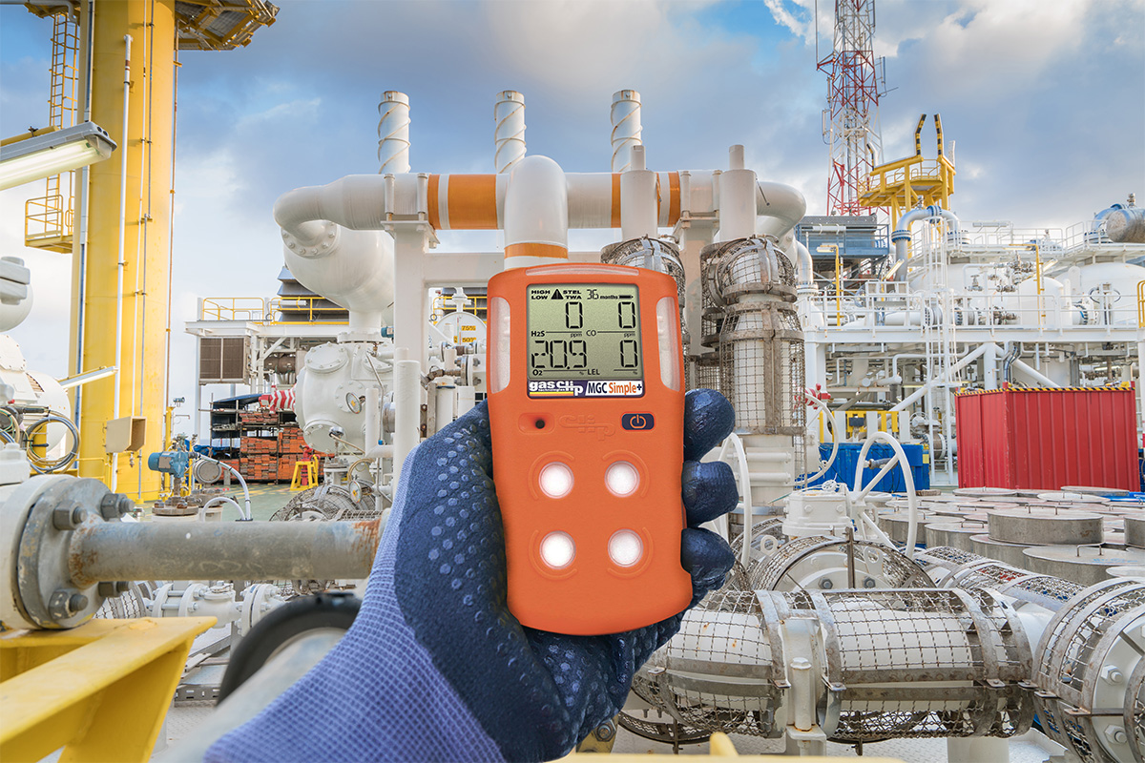
ADVANTAGES
Easy to Install Arduino.
Accurate Pollution monitoring.
Simple, compact and easily handle.
Detecting a wide range of gases.

Slide 19

APPLICATIONS
SAFETY:-
One can avoid from going to particular location by redirecting themselves or by taking safety precautions such as wearing mask and can reduce over dumped wastages in a particular locality area.
COST:-
Compared to others it’s efficient and low cost because here sensors are clubbed by using IoT and Arduino microcontroller.
SIMPLE MAINTENANCE:-
As the Project deals with the software embedded C, so maintenance will be easy

Slide 20

FUTURE SCOPE
In future the project can be upgraded in more ways than one:-
Interface more no of sensors to know gases present air quality.
Design web page and upload data on webpage.
Interface SDCARD to store data.
Interface GPS module to monitor the pollution.

Slide 21
REFERENCES
https://store.arduino.cc/arduino-uno-rev3
https://en.wikipedia.org/wiki/ESP8266
https://www.arduino.cc
https://whatis.techtarget.com/definition/LCD-liquid-crystal-display

Slide 22
THANK YOU

